Slide 1
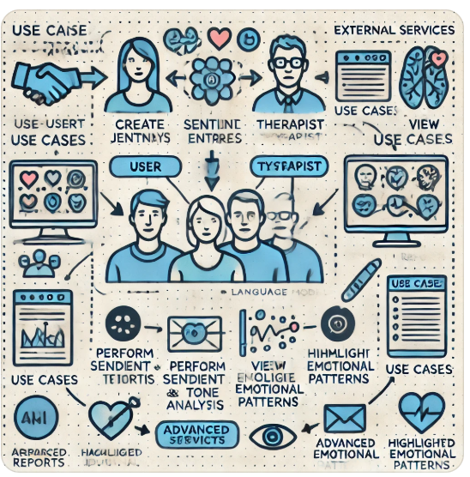
“Mentis “ your AI-powered therapy support app
Final project
Ohad Buskile 207422080
Ilana Gofman 322766932

Slide 2

Objectives
Improve therapy outcomes by offering detailed, data-driven insights into user emotions.
Empower users to reflect on their mental health journey.
Streamline therapists’ preparation for sessions, saving time and enhancing understanding.

Slide 3

Why "Mentis" is Needed
Modern therapy often relies on self-reported recollections from patients, which can be prone to:
Forgetting Details:
Users frequently forget emotional triggers or events, recalling only 40–50% of their daily emotions accurately after a week, which hinders therapists in addressing issues effectively.
Altering Memories:
Memory is reconstructed during recall and often influenced by current emotions, leading to skewed recollections that can distort therapists understanding of progress

Slide 4
Compatitors
App/Feature | AI-Powered Sentiment Analysis | Journaling Interface | Therapist Dashboard | Real-Time User Interaction | Weekly Summarization
Mentis | V | V | V | ½ | V
Woebot Health | V | X | X | V | X
MiaRec Sentiment Analysis | V | X | X | V | X
Daylio Journal | X | V | X | X | X
Reflectly | X | V | X | X | X

Slide 5
Functional Requirements
User Authentication and Authorization:
Users can securely register, log in, and manage accounts.
Role-based access control for therapists and users.
Journaling Interface:
Users can create, save, and edit daily journal entries.
Support for multilingual input.
Sentiment and Tone Analysis:
The system analyzes and tracks changes in emotional tone and sentiment over time.
Detects patterns in emotional states.
Summarization and Event Highlighting:
Provides weekly summaries of user entries.
Highlights significant emotional patterns or events for both users and therapists.

Slide 6
Functional Requirements
5. Therapist Dashboard:
Therapists receive concise, data-driven reports summarizing user progress.
Visualizations for emotional trends and insights.
6. Notifications and Reminders:
Users are notified to complete daily journal entries.
Therapists receive alerts for significant emotional changes or flagged concerns.
7. Security and Data Privacy (not for now):
All journal entries and user data are securely encrypted.
Compliance with data protection regulations (GDPR).
8. Multilingual Support (not for now):
Application supports multiple languages for journaling and analysis.

Slide 7

Apps and Tools
Core Technology: Python, for implementing and backend logic.
AI/ML Models: mt 5, hugging face
Data base: PostgreSQL
Development Tools: Git, for source code management and collaboration.
User Interface: React.js, for building a responsive and user-friendly journaling interface.
Testing and Automation: Pytest, for rigorous backend testing.

Slide 8

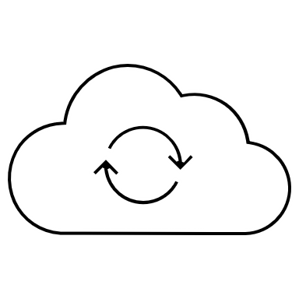


Use case diagram
Authentication
User-Client server
Journaling
S&T Analysis
Summarization
Dashboard
System (AI-Powered Application)
Notifications

Slide 9
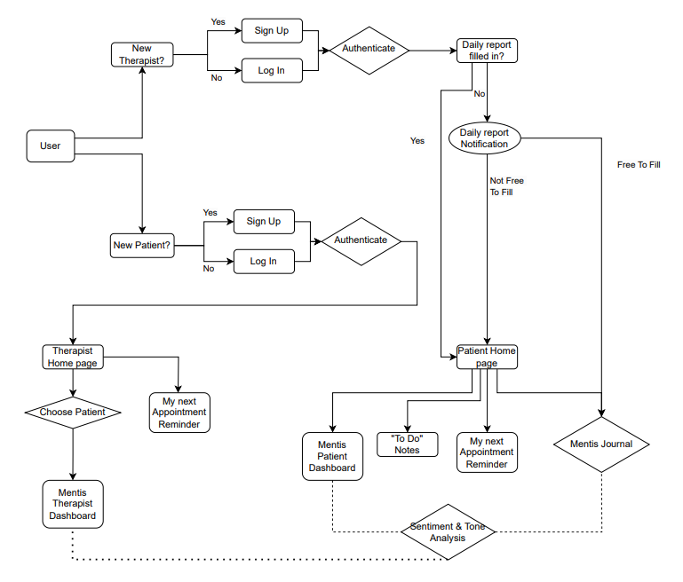
UML Diagram

Slide 10

Stakeholder Identification
End-Users: Individuals using the app for journaling.
Therapists: Professionals accessing insights for therapy preparation.
Project Managers: Oversee development and delivery timelines.
Developers/AI Specialists: Implement the NLP, LLM models, and journaling interface.
QA/Testers: Ensure app functionality, security, and performance.

